Slide 1
STRONGBOX: CONFIDENTIALITY, INTEGRITY, AND PERFORMANCE USING STREAM CIPHERS FOR FULL-DISK ENCRYPTION
Bernard Dickens III
Notes:
Solution for FDE using Stream Ciphers
StrongBox
With the purpose of providing Conf, Integ, Perf guarantees greater than or equal to state of the art

Slide 2

Full Disk Encryption?
Industry standard: AES-XTS
Notes:
FDE is securing data at rest
Hard drives, flash drives, etc
Industry standard encryption algorithm: AES-XTS used in Bitlocker, TrueCrypt/VeraCrypt, Android FDE/Linux dm-crypt, etc
So AES-XTS is necessarily the state of the art…

Slide 3
AES-XTS Block Cipher: State of the Art for FDE
Notes:
Now: AES-XTS is block cipher designed with spinning disks in mind
How it works (wide sectors narrow blocks; sector by sector, fully encrypted)
AES crypto primitive is known to be relatively slow
I/O operations on AES-XTS based FDE storage can be anywhere from 3-5x slower than unencrypted storage.
Android didn’t do FDE until android M
Can we do better?

Slide 4
Steam Ciphers: A Faster Alternative?
Notes:
AES-XTS block cipher industry standard, but not the only way to do FDE
Stream ciphers are by their very nature much faster than block ciphers.
How it works: Sectors don’t even factor in when we’re using a stream cipher.
Why not just use a stream cipher?

Slide 5
The Problem with FDE & Stream Ciphers
FDE with a Block Cipher (AES)
FDE with a Stream Cipher
Notes:
The problem w using a stream cipher for FDE…
Naïve FDE implementations using stream ciphers are trivially vulnerable!
This is due to the XOR operation, which, while fast, makes it so that any overwrite (what disks do) breaks confidentiality
This problem and its solutions are well understood by the community
The common assumption: workarounds for this problem are so expensive negate perf benefit of using stream cipher <PRESS SPACE>
Makes stream ciphers unsuitable for FDE

Slide 6
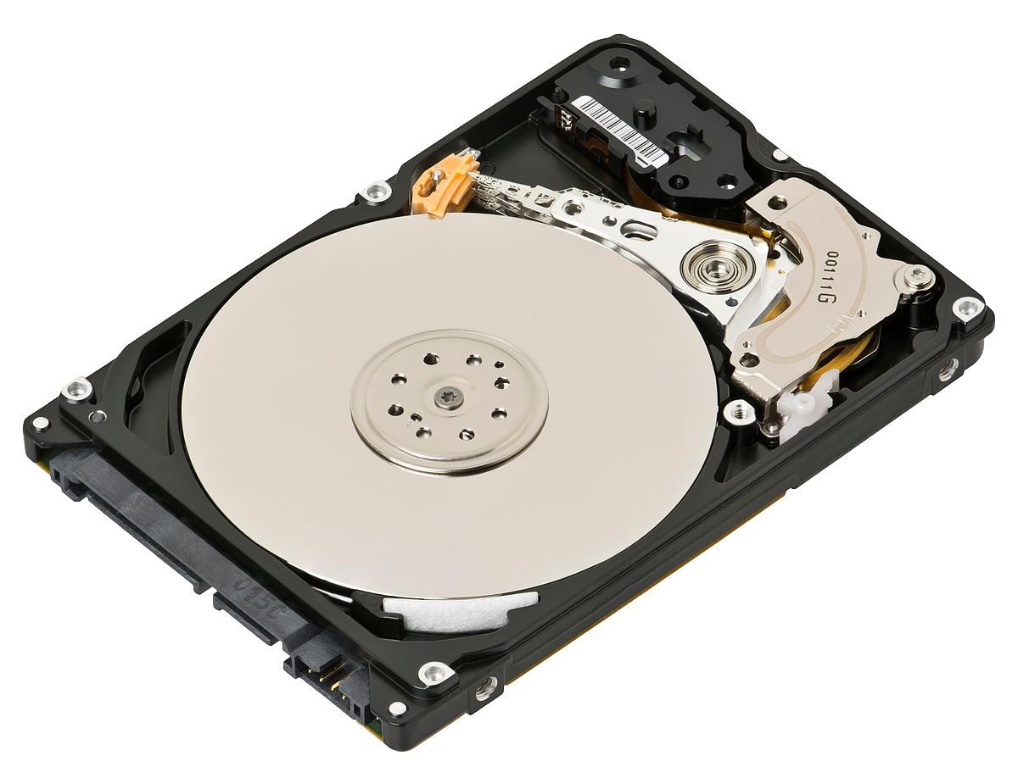
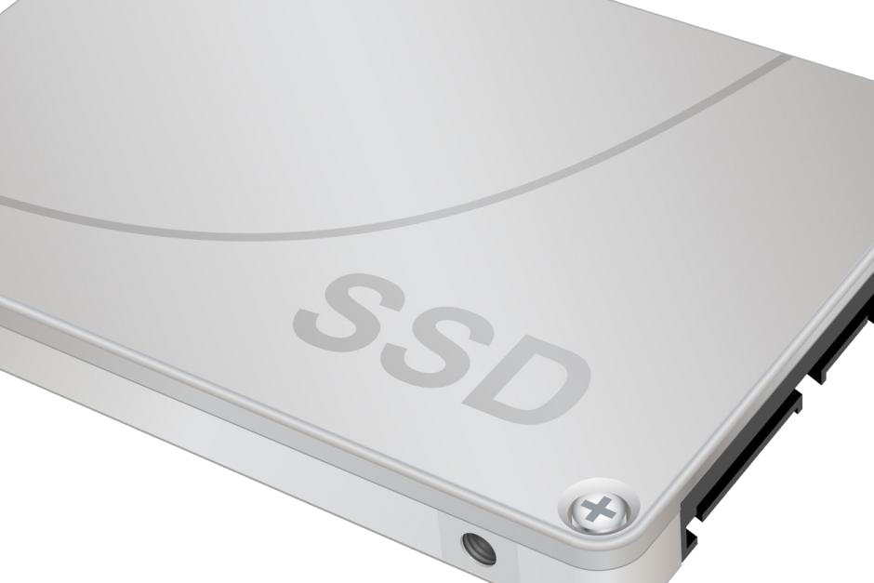
Tech Trends Invalidate Old Assumptions
Then: HDD
Now: SSD/eMMC/Flash
Sector-based disk layout
Inspired design of AES-XTS
Disk controller has Flash Translation Layer (FTL)
FTL tries to avoid overwrites to flash cells (wear-leveling)
Notes:
(keep it short!)
Trends in technology invalidate these common assumptions!
When AES-XTS conceived: primary mode of storage = spinning disks with sectors, inspired design XTS mode
Now, primary: NAND-flash, no sectors, naturally wants to avoid overwrites to extend life of flash cells

Slide 7
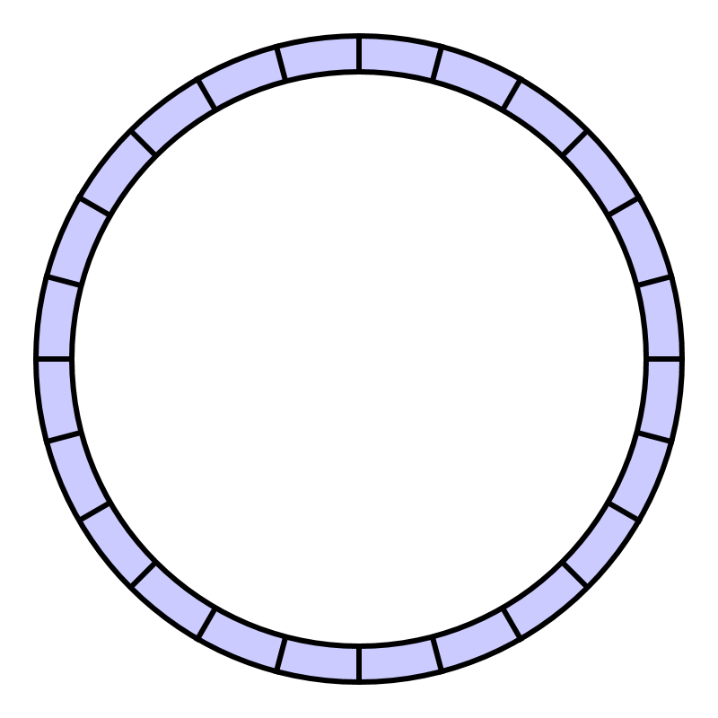
Tech Trends Invalidate Old Assumptions (cont.)
FTL operates like a Log-structure File System (LFS)
FTL = LFS = append-only writes
(naturally avoids overwrites)
Notes:
FTL wants to spread out writes as much as possible—naturally avoids overwrites (wear-leveling, operates like LFS)
LFS is append-only (append-mostly), makes as few overwrites as possible, operates like a ring buffer (see above)
Again: FTL and LFS designed to make as few overwrites as possible

Slide 8
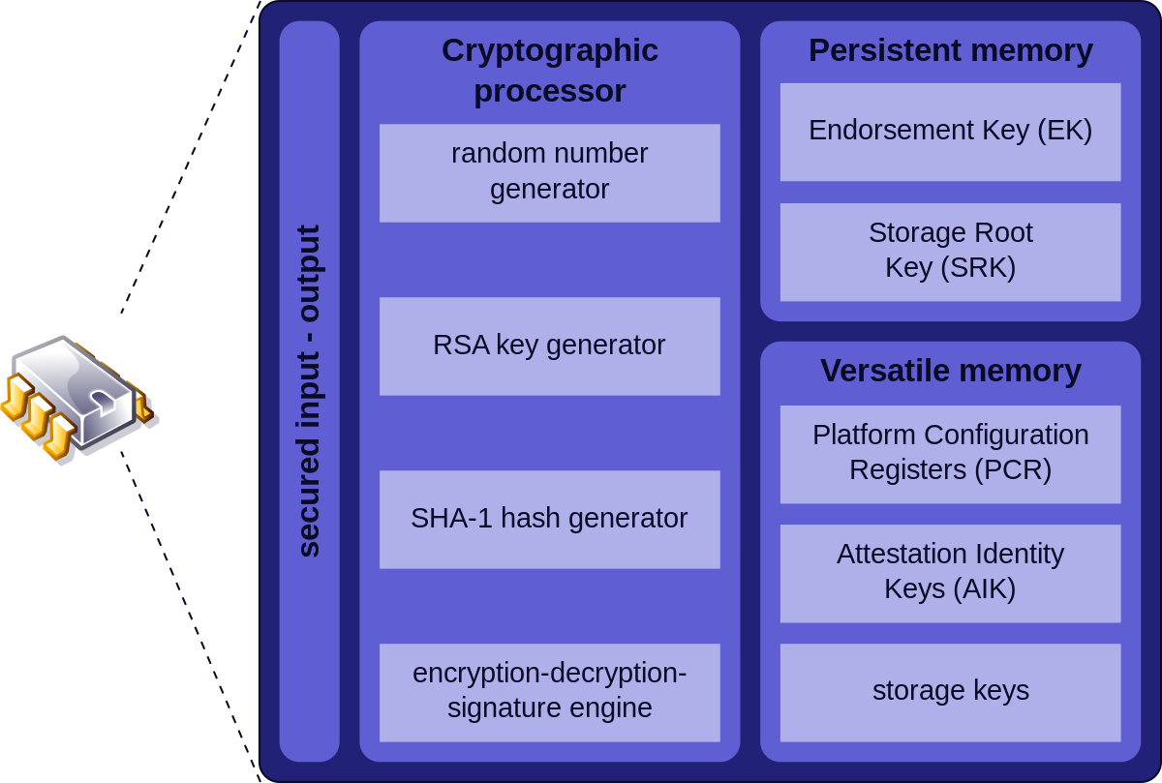
Tech Trends Invalidate Old Assumptions (cont.)
Trusted Platform Module (TPM)/TEE
TPM is used by nearly all PC manufacturers and in nearly 600 million PC/mobile devices (2009)
Supports secure monotonic counters
Notes:
Further invalidating common assumptions about FDE is proliferation of secure hardware
Secure hardware is everywhere, <CITE NUMBERS>
Provides many crypto functions; we only need one!
Secure monotonic counters are good for preserving state and can be used for versioning protecting against rollbacks and the like.

Slide 9
Solution: StrongBox
We propose StrongBox
A drop-in replacement for AES-XTS-backed FDE providers such as dm-crypt
Uses a stream cipher instead of the AES-XTS block cipher
Uses a MAC for integrity guarantee
Goals of our StrongBox implementation
Protect against many-time pad by leveraging append-only FTL/LFS
Protect against rollback attacks by leveraging secure monotonic counters
Provide a transparent performant encryption layer to OS without API changes
Provide confidentiality and integrity guarantees greater than or equal to AES-XTS

Slide 10
Roadmap
StrongBox Implementation Overview
Threat Model
Strongbox Performance Evaluation
Conclusion and Future Work

Slide 11
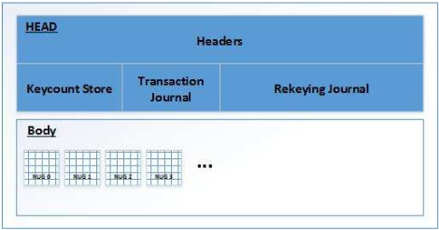
StrongBox: Backing Storage Layout

Slide 12
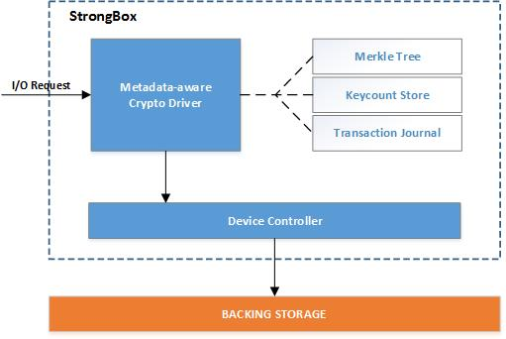
StrongBox: Component Overview
Notes:
Primary data structures that compose SB are:
Transaction journal: bit vector used by StrongBox to track dirty flakes and used to detect overwrites
Keycount store: used by StrongBox as a nonce that determines derived nugget keys and is incremented during rekeying; protects against many-time pad
Merkle tree: used by StrongBox to ensure the integrity of nuggets, the metadata header, and secure counter value; protect against rollback

Slide 13
Roadmap
StrongBox Implementation Overview
Threat Model
Strongbox Performance Evaluation
Conclusion and Future Work

Slide 14

Threat Model 1: Passive Attack on Data at Rest
Data confidentiality
AES-XTS ensures confidentiality with the AES block cipher
StrongBox ensures confidentiality with ChaCha20
Notes:
First threat is the threat FDE was created to address

Slide 15









Threat Model 2: Many-time Pad Attack
d ⊕ pad = c
d’ ⊕ pad = c’
c ⊕ c’ = BROKEN!
**http://dann.com.br
Notes:
First image
Xor with keystream or pad indistinguishable from random
Output indistinguishable from random
Overwrites are many time pads!

Slide 16
Threat Model 2: Many-time Pad Attack (cont.)
StrongBox addresses this problem in two ways:
Maintaining metadata and rekeying to prevent multiple pads
Many-time pad only possible with overwrites
Maintain bit vector of flakes to detect potential overwrites
When an overwrite would occur, re-encrypt affected nugget with the new key (rekeying)
Leveraging FTL/LFS append-only nature
Expensive rekeying occurs when potential overwrites are detected
Remain performant by overwriting flakes as few times as possible
An append-only/mostly file system makes few overwrites!
Notes:
Two ways:
Track writes to ensure that the same location is never overwritten
<GO TO SECOND BULLET!>
2. Few overwrites
Allows us to remain performant!

Slide 17

Threat Model 3: Rollback Attack
Rollbacks not covered by the AES-XTS threat model
Rollbacks must be considered for StrongBox
StrongBox leverages TPM/TEE to provide a secure monotonic counter to protect against rollback
This counter is included in the Merkle tree calculation
This counter is updated after every write (versioning)
Any attempts at rollback will cause a counter mismatch and subsequent integrity failure

Slide 18
Threat Model 4: Data Integrity
Data integrity
AES-XTS uses XEX-based ECB mode (XTS) to “guarantee” integrity
StrongBox uses Poly1305 MAC and Merkle Tree construction to guarantee integrity

Slide 19
Roadmap
StrongBox Implementation Overview
Threat Model
Strongbox Performance Evaluation
Conclusion and Future Work

Slide 20
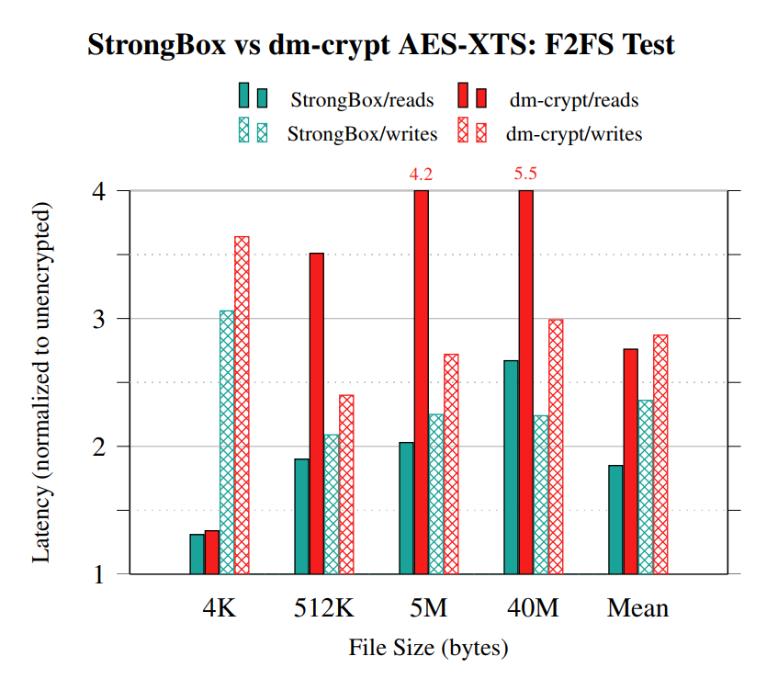
Performance Evaluation
Notes:
FOR F2FS MOUNTED ATOP <READ TITLE>:
StrongBox is faster than dm-crypt in all cases.
(normalized to perf of unencrypted storage)
By harmonic mean:
1.6× faster for reads
1.2× faster for writes

Slide 21
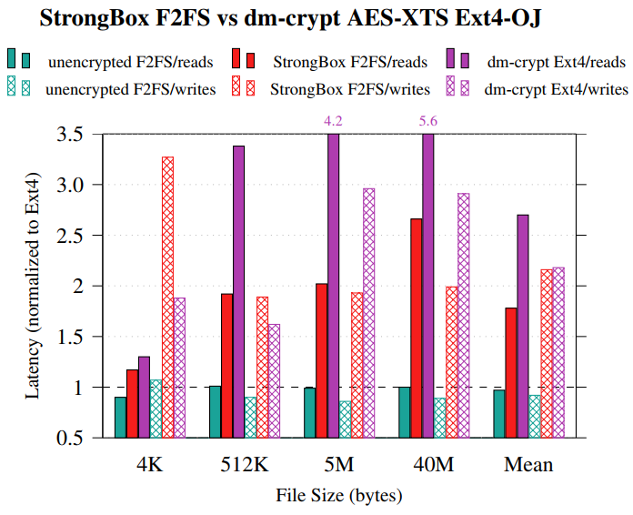
Performance Evaluation (cont.)
Notes:
This chart shows StrongBox under a suitable LFS is faster than dm-crypt under Ext4 (standard configuration) in all cases for reads
Normalized to unencrypted Ext4 performance.
Unencrypted F2FS is slower than unencrypted Ext4 for small writes such as ~4KB. This disparity balloons with StrongBox overhead. Otherwise, Strongbox under F2FS achieves parity or outperforms dm-crypt under Ext4 for writes as well.
By harmonic mean:
1.5x faster reads
achieves virtual parity for writes

Slide 22
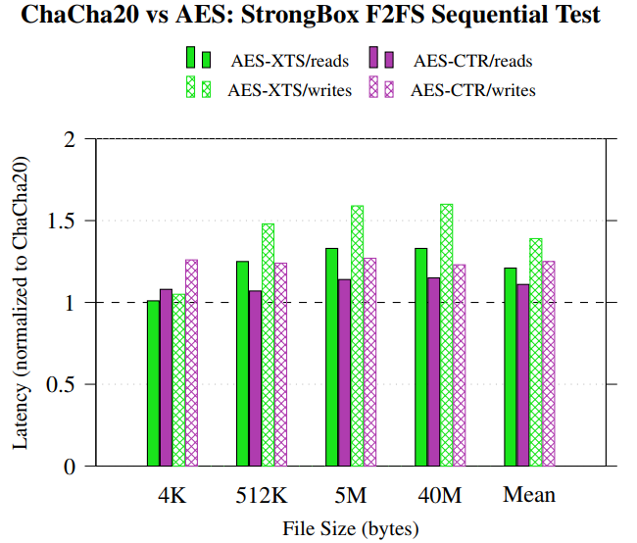
Performance Evaluation (cont.)
Notes:
Now, to help determine the source of our perf win, we implemented SB with AES-XTS and AES-CTR.
StrongBox with ChaCha20 is faster than StrongBox with AES-XTS.
Chart is normalized to SB perf with ChaCha20
SLOWDOWN by harmonic mean:
1.2x AES-XTS read slowdown
1.4x AES-XTS write slowdown
1.1x AES-CTR read slowdown
1.3x AES-CTR write slowdown
Perf gap here between ciphers doesn’t completely explain performance gap between SB and dm-crypt; suggeests there may be room for optimization in dm-crypt; outside scope of this research

Slide 23
Roadmap
StrongBox Implementation Overview
Threat Model
Strongbox Performance Evaluation
Conclusion and Future Work

Slide 24
Conclusion
AES-XTS is currently FDE state of the art
Key assumptions regarding overhead of stream cipher based FDE are no longer valid thanks to technical trends
StrongBox overcomes assumptions, is a drop-in dm-crypt replacement
capable of using any applicable stream cipher and MAC combination
can be implemented at the device level or at the disk controller level (FTL)
StrongBox under F2FS outperforms dm-crypt AES-XTS under F2FS and Ext4
Notes:
Read 1
Key assumptions regarding workarounds for FDE probs with stream ciphers are no longer valid thanks to tech trends
Read 3

Slide 25
Future Work and Improvements
Integrate StrongBox into F2FS directly
Explore the trade-off between energy, performance, and security
Investigate ChaCha20 energy use
Notes:
So, this research presents several interesting opportunities for further study.
Energy use was not main focus, Performance gain w/ ChaCha20 accompanied by proportional power increase; deserving of closer scrutiny.

Slide 26
Any Questions?
END

